Slide 1

NY HCUP DATA ANALYSIS
Grace sigalla

Slide 2

2017 SEDD
The data file has 6966265 observations with 603 columns, therefore I opted to only work with a sample, to save time
The sample contains 30000 observations

Slide 3
Data cleaning and Transformation
Our data contains 6012266 null values which I chose to keep, no imputing or dropping null values.
Performed data transformation to create age groups, race and ethnicity column, re-labeled the gender and died variables, and payment options

Slide 4
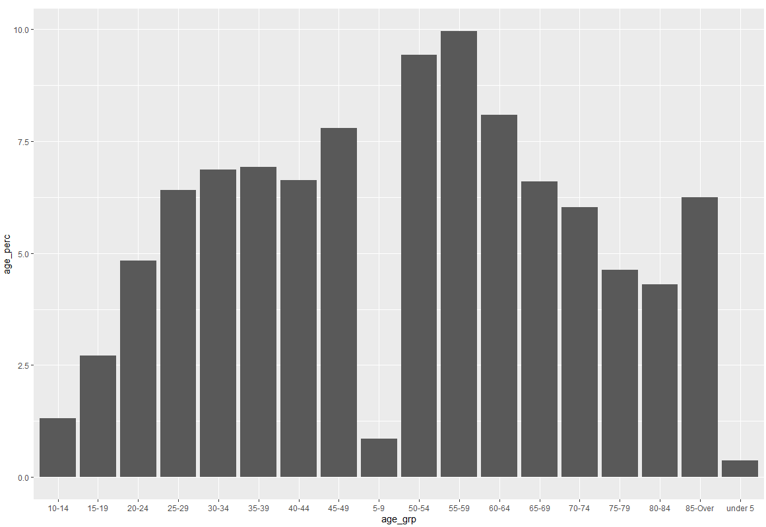
EXPLORATORY DATA ANALYSIS (EDA)
AGE
DEATH STATUS
DIED | PERCENTAGE
Lived | 99.75
Died | 0.16
NA | 0.09
GENDER
FEMALE | PERCENTAGE
Male | 46.16
Female | 53.82
NA | 0.01
Notes:
AGE - According to the 2017 NY SEDD core data collected, majority of the population who visited the state's emergency department were in their 30-65.
GENDER – Females by almost 10%
Death Status – mostly lived, by over 99%

Slide 5
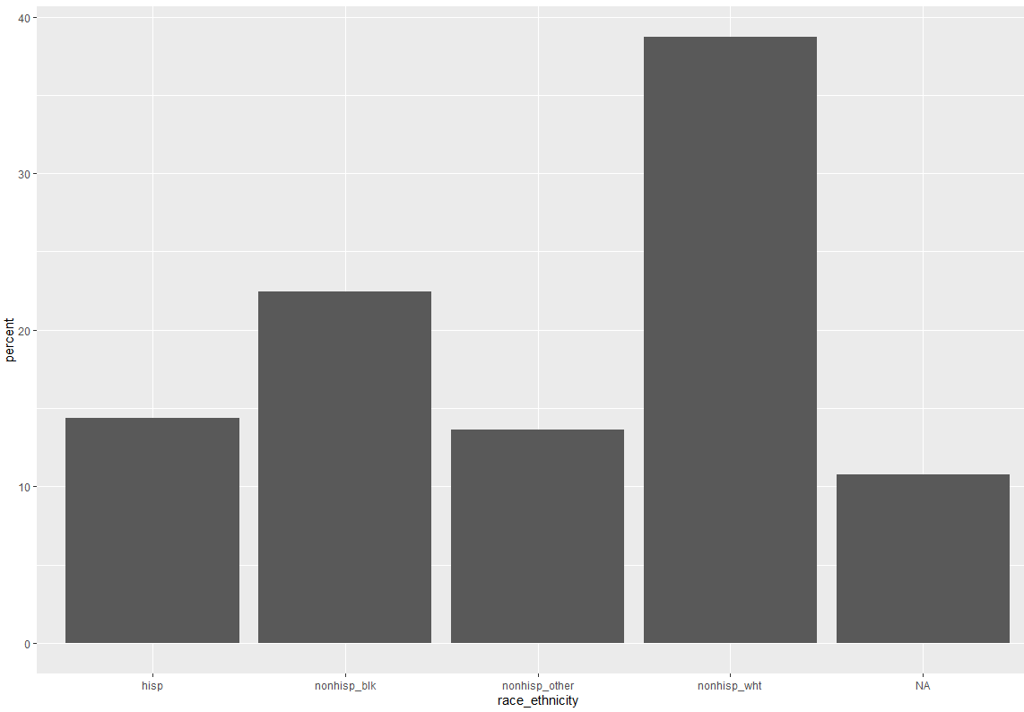
EDA CONT.
RACE-ETHNICITY
PAYMENT METHODS
PAY1 | PERCENT
Medicare | 17.12
Medicaid | 41.65
Private Insurance | 28.14
Self-pay | 9.97
No Charge | 0.21
Other | 2.74
NA | 0.17
Notes:
Race ethnicity – by almost 40%, mostly non-Hispanic white
Payment – Medicaid by 42% and followed by private insurance 28%

Slide 6
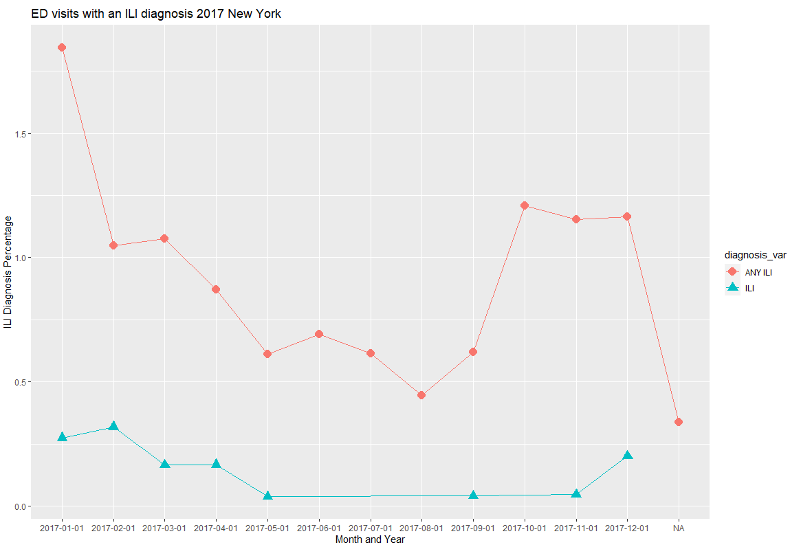
Influenza and Influenza Like Diagnosis
Given that we are working with a random sample, it is not containing first ILI diagnosis from May to October.
When running the code on just the first 30,000 rows, results came back the same. We believe the results will come out different when the code is run on the entire dataset.
The pattern we see here is that during the colder seasons, January and December, there is an increase in influenza and influenza like diagnosis.

Slide 7
ILI and Other Diagnosis Comparison Table
Table 1. Disparities in ILI-related ED visits by patient and community characteristics, 2017, New York
Characteristic | ILI-related ED visits |  |  | Total ED visits with or without ILI, N
 | Total, N | Population rate‡ | Of all ED visits, %
Any ILI diagnosis
Flu season 2017 | 329 | 1096.666667 | 1.096666667 | 30,000
ILI diagnosis type
Influenza only | 24 | 80 | 0.08 | 30,000
Influenza-like illness only | 305 | 1016.666667 | 1.016666667 | 30,000
Both | 2 | 6.666666667 | 0.006666667 | 30,000
Age, years
<18 | 149 | 2452.674897 | 2.452674897 | 6,075
18-64 | 154 | 783.8745801 | 0.78387458 | 19,646
65+ | 26 | 607.6186025 | 0.607618602 | 4,279
Race/ethnicity*
Asian/Pacific Islander | 10 | 929.3680297 | 0.92936803 | 1076
Black | 108 | 1511.758119 | 1.511758119 | 7144
Hispanic | 88 | 1530.434783 | 1.530434783 | 5750
White | 89 | 732.0282941 | 0.732028294 | 12158
Other | 34 | 893.7960042 | 0.893796004 | 3804
Primary expected payer
Medicare | 36 | 696.5944272 | 0.696594427 | 5168
Medicaid | 203 | 1621.017328 | 1.621017328 | 12523
Private insurance | 57 | 672.3283793 | 0.672328379 | 8478
Self-pay/No charge| | 28 | 971.2105446 | 0.971210545 | 2883
Other | 3 | 349.6503497 | 0.34965035 | 858
Location of residence
Adjacent | 299 | 1096.724498 | 1.096724498 | 27263
Non-adjacent | 22 | 1177.730193 | 1.177730193 | 1868
Rural remote | 8 | 1149.425287 | 1.149425287 | 696
Community income
Quartile 1 (lowest) | 159 | 1420.023221 | 1.420023221 | 11197
Quartile 2 | 100 | 1291.655903 | 1.291655903 | 7742
Quartile 3 | 47 | 800.9543286 | 0.800954329 | 5868
Quartile 4 (highest) | 21 | 434.3329886 | 0.434332989 | 4835
No ILI diagnosis | 29671 | 98903.33333 | 98.90333333 | 30,000

Slide 8
2017 SID
The data file has 2362414 observations with 251 columns, therefore I opted to only work with a random sample of it, to save time.
The sample contains 60000 observations

Slide 9
Data cleaning and Transformation
Our data contains 4549970 which we chose to keep, no imputing or dropping null values.
Performed data transformation to create age groups, race and ethnicity column, re-labeled the gender and died variables, and payment options

Slide 10
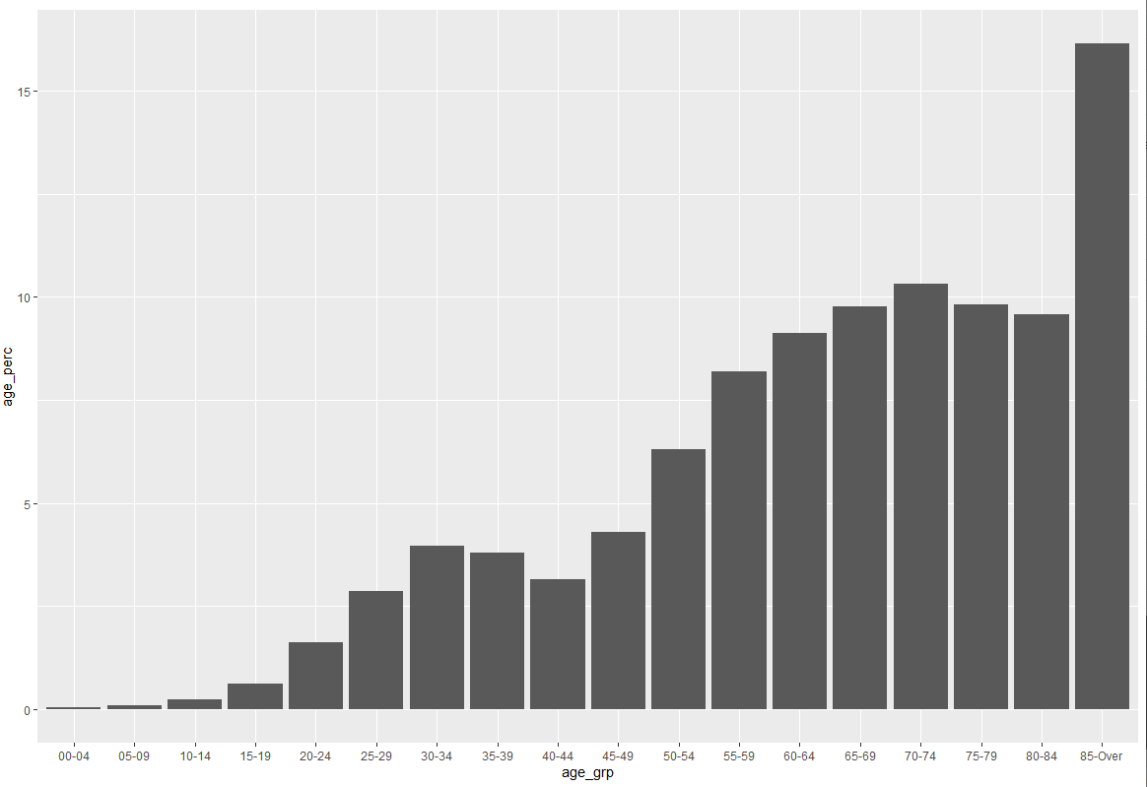
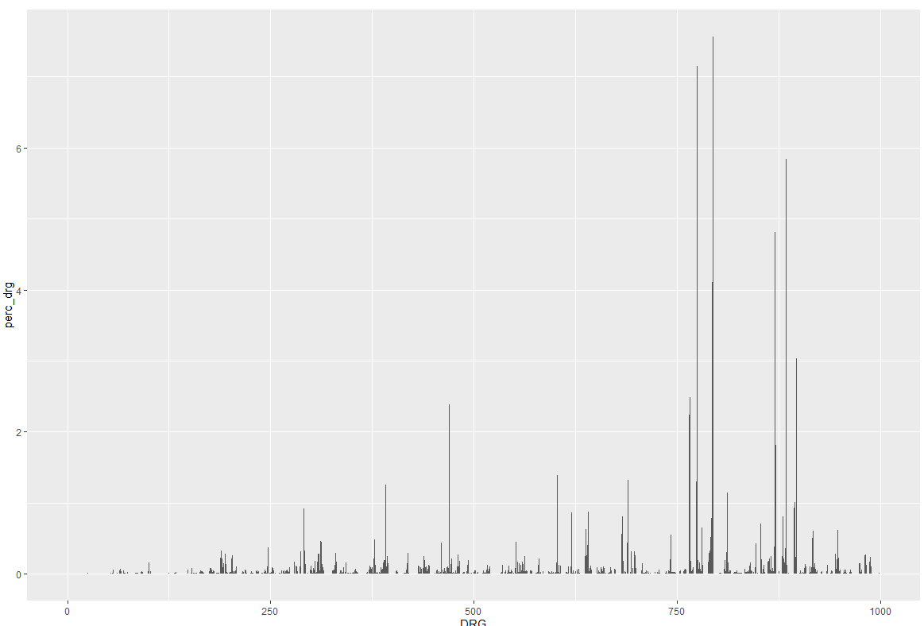
EXPLORATORY DATA ANALYSIS (EDA)
AGE
DRG
Notes:
AGE - According to the 2017 NY SID core data collected, majority of the population who visited the state's emergency department were between mostly 65+
DRG – approximately DRG group 780 had the highest percentage, followed by DRG 830

Slide 11
EXPLORATORY DATA ANALYSIS (EDA)
DEATH STATUS
GENDER
DIED | PERCENTAGE
Lived | 97.85
Died | 2.15
FEMALE | PERCENTAGE
Male | 44.71
Female | 55.28
NA | 0.01
Notes:
According to the 2017 NY SID core data collected, majority of the population who were inpatients lived, about 98% and over 55% of them were females.

Slide 12
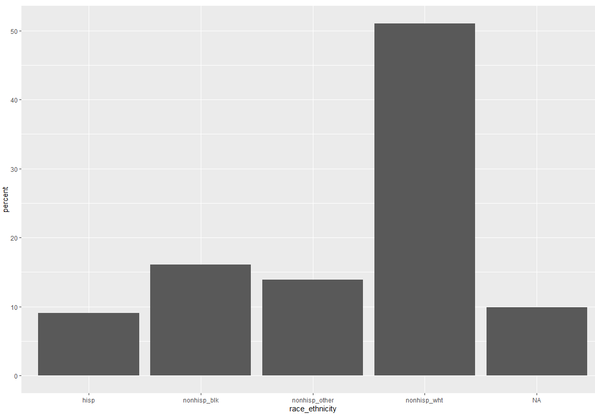
EDA CONT.
RACE-ETHNICITY
PAYMENT METHODS
PAY1 | PERCENT
Medicare | 38.62
Medicaid | 30.09
Private Insurance | 27.73
Self-pay | 1.89
No Charge | 0.1
Other | 1.47
NA | 0.11
Notes:
Race ethnicity – by almost 50%, mostly non-Hispanic white
Payment – Medicare by 39% and followed by Medicaid at 30%

Slide 13
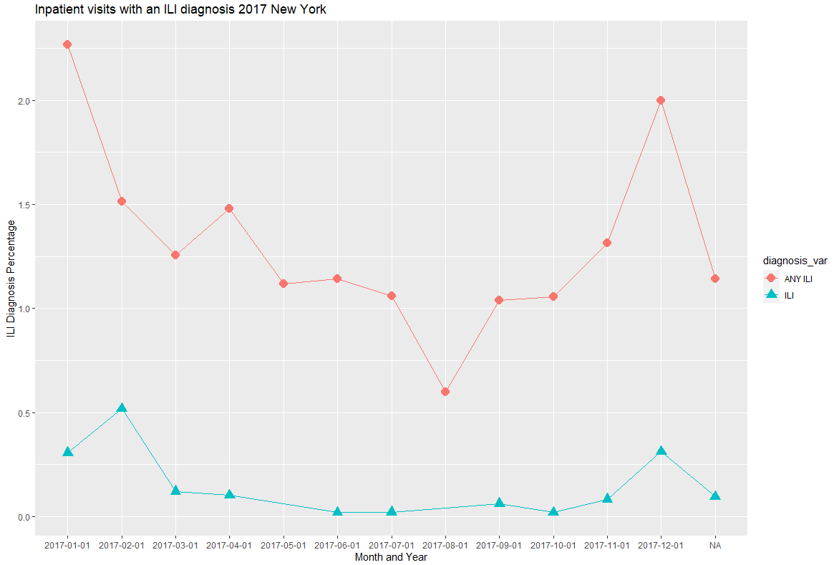
Influenza and Influenza Like Diagnosis
Given that we are working with a random sample. It is not containing first ILI diagnosis for the month of August.
The pattern we see here is that during the colder seasons, January and December, there is an increase in influenza like diagnosis. However, for influenza, there was a spike in February, and then again in December.

Slide 14
ILI and Other Diagnosis Comparison Table
Table 1. Disparities in ILI-related Inpatient visits by patient and community characteristics, 2017, New York
Characteristic | ILI-related Inpatient visits |  |  | Total Inpatient visits with or without ILI, N
 | Total, N | Population rate‡ | Of all Inpatient visits, %
Any ILI diagnosis
Flu season 2017 | 868 | 1446.666667 | 1.446666667 | 60,000
ILI diagnosis type
Influenza only | 77 | 128.3333333 | 0.128333333 | 60,000
Influenza-like illness only | 791 | 1318.333333 | 1.318333333 | 60,000
Both | 8 | 13.33333333 | 0.013333333 | 60,000
Age, years
<18 | 145 | 1699.484294 | 1.699484294 | 8,532
18-64 | 257 | 859.1007856 | 0.859100786 | 29,915
65+ | 466 | 2162.112003 | 2.162112003 | 21,553
Race/ethnicity*
Asian/Pacific Islander | 20 | 672.2689076 | 0.672268908 | 2975
Black | 120 | 1181.451216 | 1.181451216 | 10157
Hispanic | 92 | 1174.218251 | 1.174218251 | 7835
White | 560 | 1770.91898 | 1.77091898 | 31622
Other | 75 | 1032.915576 | 1.032915576 | 7261
Primary expected payer
Medicare | 518 | 2218.510429 | 2.218510429 | 23349
Medicaid | 220 | 1224.807928 | 1.224807928 | 17962
Private insurance | 117 | 705.3291536 | 0.705329154 | 16588
Self-pay/No charge| | 7 | 621.669627 | 0.621669627 | 1126
Other | 6 | 691.2442396 | 0.69124424 | 868
Location of residence
Adjacent | 780 | 1396.948205 | 1.396948205 | 55836
Non-adjacent | 64 | 2278.390886 | 2.278390886 | 2809
Rural remote | 22 | 1911.381407 | 1.911381407 | 1151
Community income
Quartile 1 (lowest) | 275 | 1601.724038 | 1.601724038 | 17169
Quartile 2 | 218 | 1522.240067 | 1.522240067 | 14321
Quartile 3 | 200 | 1414.827391 | 1.414827391 | 14136
Quartile 4 (highest) | 169 | 1221.804511 | 1.221804511 | 13832
No ILI diagnosis | 59132 | 98553.33333 | 98.55333333 | 60,000

Slide 15
SID 2017 Influenza and Influenza Like Monthly Population Rate (per 100,000) per census 2015-2019
DATE | DIAGNOSIS | TOTAL | PERCENT
January | ILI | 25 | 0.13
January | ANY ILI | 104 | 0.53
February | ILI | 22 | 0.11
February | ANY ILI | 73 | 0.37
March | ILI | 12 | 0.06
March | ANY ILI | 59 | 0.3
April | ILI | 7 | 0.036
April | ANY ILI | 70 | 0.36
May | ILI | 2 | 0.01
May | ANY ILI | 57 | 0.29
June | ILI | 1 | 0.005
June | ANY ILI | 59 | 0.3
July | ILI | 1 | 0.005
July | ANY ILI | 53 | 0.27
DATE | DIAGNOSIS | TOTAL | PERCENT
August | ILI | N/A | N/A
August | ANY ILI | 34 | 0.17
September | ILI | 1 | 0.005
September | ANY ILI | 55 | 0.28
October | ILI | N/A | N/A
October | ANY ILI | 50 | 0.26
November | ILI | 2 | 0.01
November | ANY ILI | 66 | 0.34
December | ILI | 11 | 0.06
December | ANY ILI | 95 | 0.49
Notes:
For influenza, there was a higher diagnosis in the months of January and December.
However, for influenza like diagnosis, there was an increase in January, February and December.

Slide 16
2018 SID
The data file has 2337668 observations with 255 columns, therefore I opted to only work with a random sample of it, to save time.
The sample contains 60000 observations

Slide 17
Data cleaning and Transformation
Our data contains 4708181 which we chose to keep, no imputing or dropping null values.
Performed data transformation to create age groups, race and ethnicity column, re-labeled the gender and died variables, and payment options

Slide 18

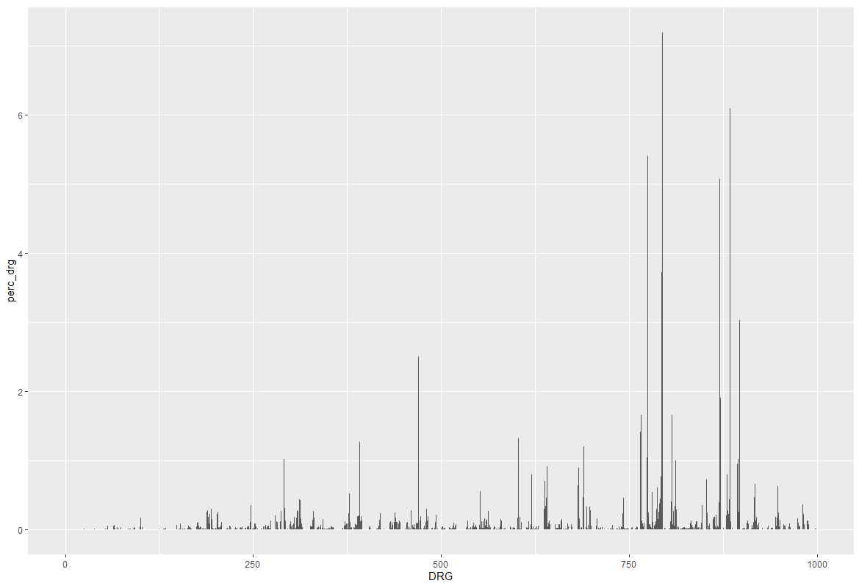
EXPLORATORY DATA ANALYSIS (EDA)
AGE
DRG
Notes:
AGE - According to the 2018 NY SID core data collected, majority of the population who visited the state's emergency department were those aged 55 and over, with the highest being 85+
DRG – approximately DRG group 780 had the highest percentage, followed by DRG 830

Slide 19
EXPLORATORY DATA ANALYSIS (EDA)
DEATH STATUS
GENDER
DIED | PERCENTAGE
Lived | 97.79
Died | 2.21
FEMALE | PERCENTAGE
Male | 44.95
Female | 55.03
NA | 0.03
Notes:
The population who were inpatients lived by about 98% and 55% of them were females.

Slide 20
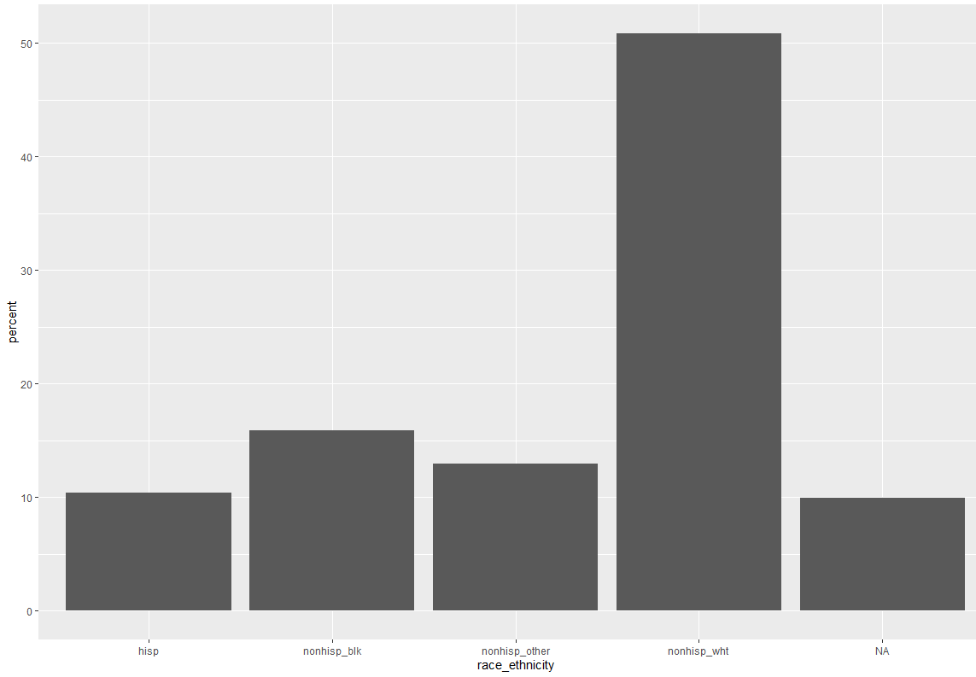
EDA CONT.
RACE-ETHNICITY
PAYMENT METHODS
PAY1 | PERCENT
Medicare | 39.9
Medicaid | 28.67
Private Insurance | 28.41
Self-pay | 1.49
No Charge | 0.08
Other | 1.44
NA | 0.02
Notes:
Race ethnicity – by almost 50%, mostly non-Hispanic white
Payment – Medicare by 40% and followed by Medicaid and private insurance at 28%

Slide 21
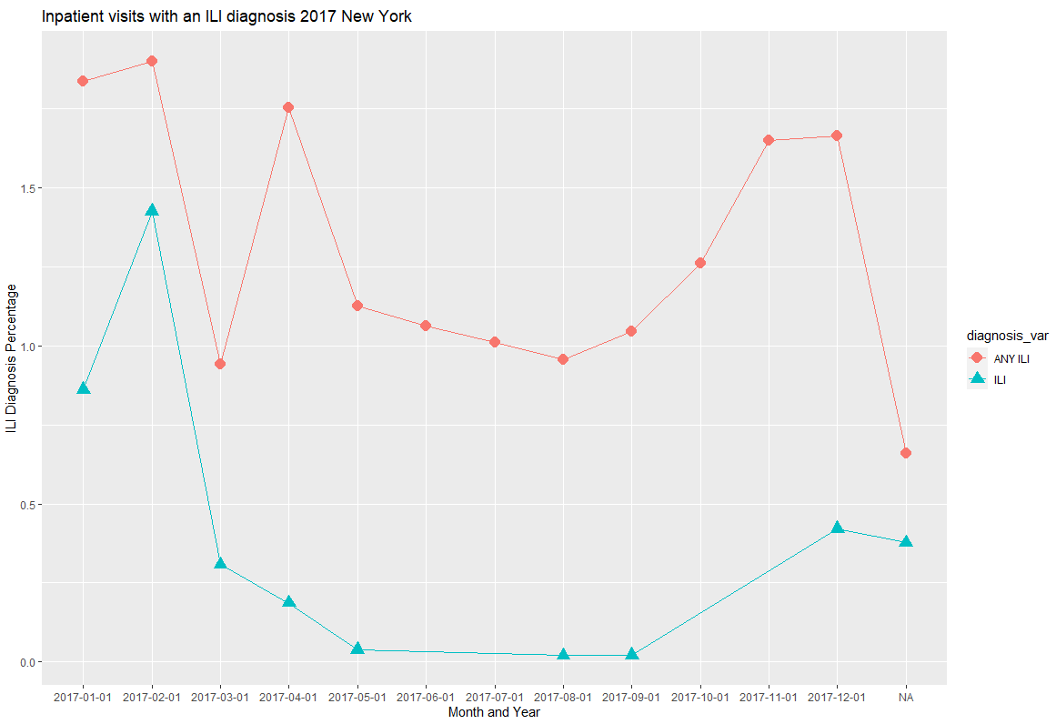
Influenza and Influenza Like Diagnosis
Given that we are working with a random sample. It is not containing first ILI diagnosis for the month of June, July, October and November.
The pattern we see here is that during the colder seasons, January, February and December, there is an increase in influenza and influenza like diagnosis.

Slide 22
ILI and Other Diagnosis Comparison Table
Table 1. Disparities in ILI-related Inpatient visits by patient and community characteristics, 2018, New York
Characteristic | ILI-related Inpatient visits |  |  | Total Inpatient visits with or without ILI, N
 | Total, N | Population rate‡ | Of all Inpatient visits, %
Any ILI diagnosis
Flu season 2017 | 965 | 1608.333333 | 1.608333333 | 60,000
ILI diagnosis type
Influenza only | 163 | 271.6666667 | 0.271666667 | 60,000
Influenza-like illness only | 802 | 1336.666667 | 1.336666667 | 60,000
Both | 35 | 58.33333333 | 0.058333333 | 60,000
Age, years
<18 | 182 | 2221.679688 | 2.221679688 | 8,192
18-64 | 294 | 991.5014164 | 0.991501416 | 29,652
65+ | 489 | 2207.07709 | 2.20707709 | 22,156
Race/ethnicity*
Asian/Pacific Islander | 39 | 1275.343362 | 1.275343362 | 3058
Black | 143 | 1424.444666 | 1.424444666 | 10039
Hispanic | 143 | 1641.037411 | 1.641037411 | 8714
White | 560 | 1778.850735 | 1.778850735 | 31481
Other | 78 | 1186.311787 | 1.186311787 | 6575
Primary expected payer
Medicare | 532 | 2222.407887 | 2.222407887 | 23938
Medicaid | 260 | 1511.276447 | 1.511276447 | 17204
Private insurance | 156 | 915.0633505 | 0.915063351 | 17048
Self-pay/No charge| | 5 | 561.1672278 | 0.561167228 | 891
Other | 12 | 1393.728223 | 1.393728223 | 861
Location of residence
Adjacent | 869 | 1555.507822 | 1.555507822 | 55866
Non-adjacent | 78 | 2798.708288 | 2.798708288 | 2787
Rural remote | 18 | 1507.537688 | 1.507537688 | 1194
Community income
Quartile 1 (lowest) | 313 | 1805.803958 | 1.805803958 | 17333
Quartile 2 | 267 | 1815.462025 | 1.815462025 | 14707
Quartile 3 | 223 | 1607.902516 | 1.607902516 | 13869
Quartile 4 (highest) | 154 | 1135.107246 | 1.135107246 | 13567
No ILI diagnosis | 59035 | 98391.66667 | 98.39166667 | 60,000

Slide 23
SUMMARY
SEDD | SID
Majority of the population is observed to be under 65 years of age | Majority of the population is observed to be over 65
Most common payment method is Medicaid | Most common payment method is Medicare
It is observed that there is almost 10% more women attendance, compared to men | It is observed that there is almost 10% more women attendance, compared to men
About 93% are individuals diagnosed with ANY-ILI | About 91% are individuals diagnosed with ANY-ILI
Mostly individuals who live in urban areas and in the 1st and 2nd quartile for income | Mostly individuals who live in urban areas and in the 1st and 2nd quartile for income

Slide 24
Challenges
Understanding the different data variables as defined by HCUP SID and SEDD
Very large data sets
Presence of null values

Slide 25

Thank you!

